Slide 1








AGNETHON
AGNETHON
-- Code. Collaborate. Conquer --
DATE: 24 - 25 February 2024
VENUE: Online
Deadline for Registration : 23rd February 2024
Fr. C. Rodrigues Institute of Technology, Vashi, Navi Mumbai

Slide 2
Agnethon Team Details
Problem Statement Title: Develop an online virtual classroom with attendance tracking, admin dashboard, automated Zoom Meeting links. etc
Team name : Code Crusaders
Domain: Web Development
Team leader name: Gabriel Sebastian Dsouza
Member 1: Durvesh Mahajan
Member 2: Xavier Peter Monteiro
Member 3: Aayush Nehete

Slide 3
Idea /Approach Details
Your idea /Solution /Prototype
Objective
Creating a website using HTML with CSS and JavaScript as Frontend.
Users can register their accounts via an admin or student registration
Backend which will be handled by using PHP
To Create a Virtual Classroom
Link the Zoom app using APIs
Create separate classrooms based on age/grades
The ability to stream offline and online classes
Integrate an attendance tracking on students

Slide 4
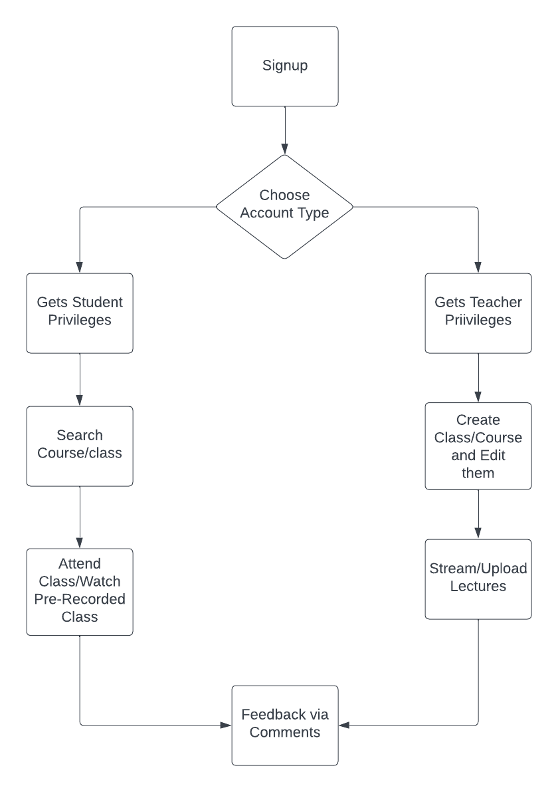
Idea /Approach Details
Technology Stack
FrontEnd: HTML, CSS, JavaScript
BackEnd: PHP

Slide 5
Show Stoppers
User Friendly UI
Unique Functionalities & Features
Innovative Solution
Dependencies: Web Servers, Cloud Servers, Database Systems, Databases

Slide 6
Conclusion
We have designed a website relating to Virtual/online Classrooms where users can seeks can apply for their desired courses and stream them in online and offline mode.

